Slide 1
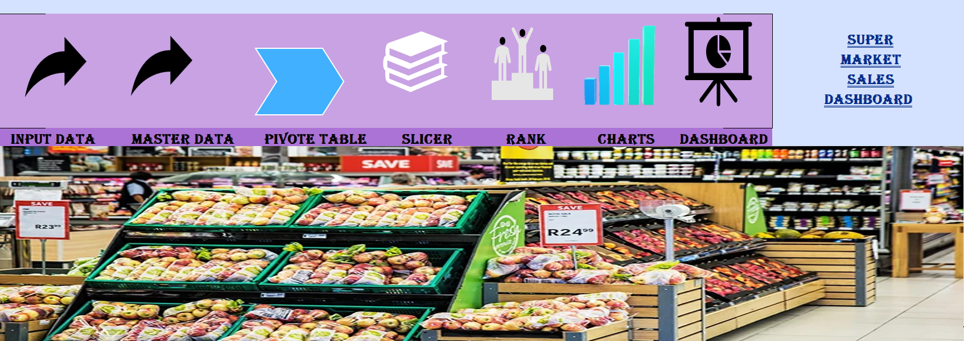
SUPER MARKET SALES DASHBOARD

Slide 2
Data Overview
taken data from https://www.kaggle.com/
Two excel worksheet contain
1)input data 2)master data
530 Rows & 17 columns
Size 1.8 mb

Slide 3
Purpose
provide a visual, real-time overview of sales and performance.
Tracking Sales Performance
Identifying Sales Trends
For Improving Business Efficiency

Slide 4
Key Matrics
Total sales
Total profit
Profit percentage
By year & month
By product category
Payment mode(cash , online)
Sale type (direct sales , online wholesaler)

Slide 5
Basic Structure
Pivot table
table
Conditional formatting
Pivot chart
Charts
Slicer
Offset function
Sum, count, min, max, If, iferror, vlookup, rank
Hyperlinks.
Data validation

Slide 6
Workflow
Gather data
Data integration
Organize data (af)
table
Create pivot table
Pivot chart
slicer
Create table using offset
rank
Combine data charts
Design dashboard

Slide 7
Scope
meet evolving business needs
improve decision-making
Real-Time Data Integration
Enhanced Data Visualization
Self-Service Analytics

Slide 8


Slide 9
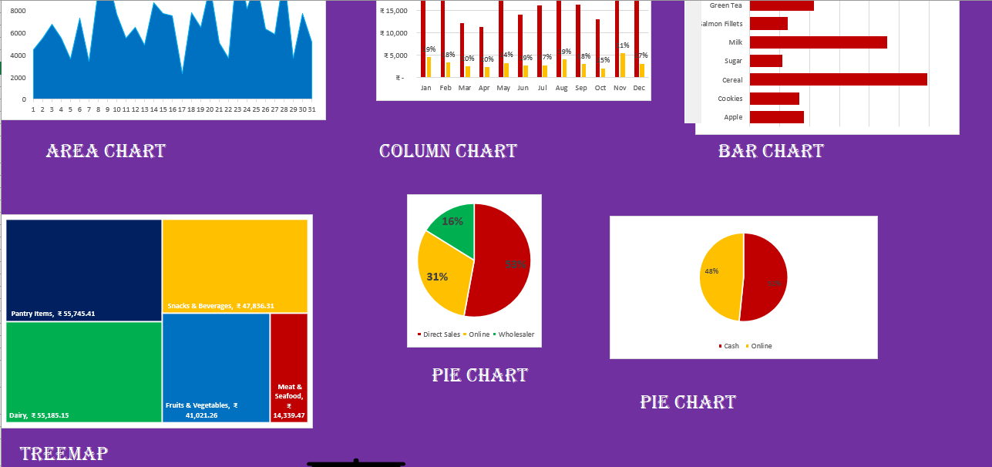

Slide 10
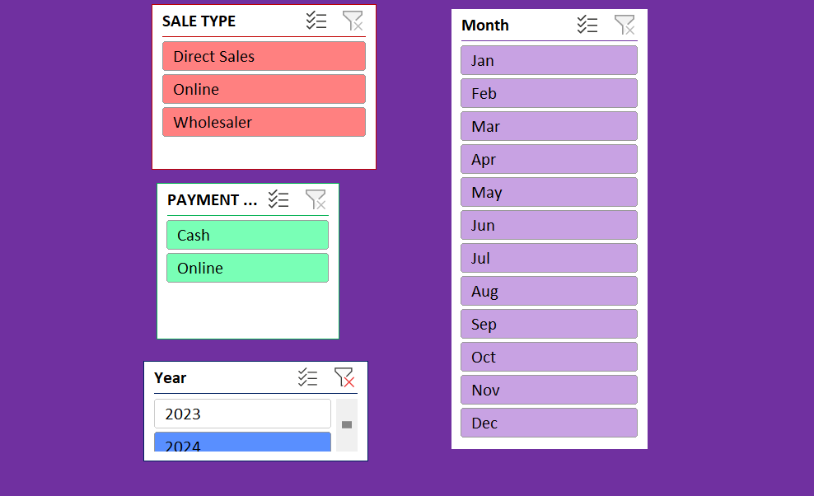

Slide 11
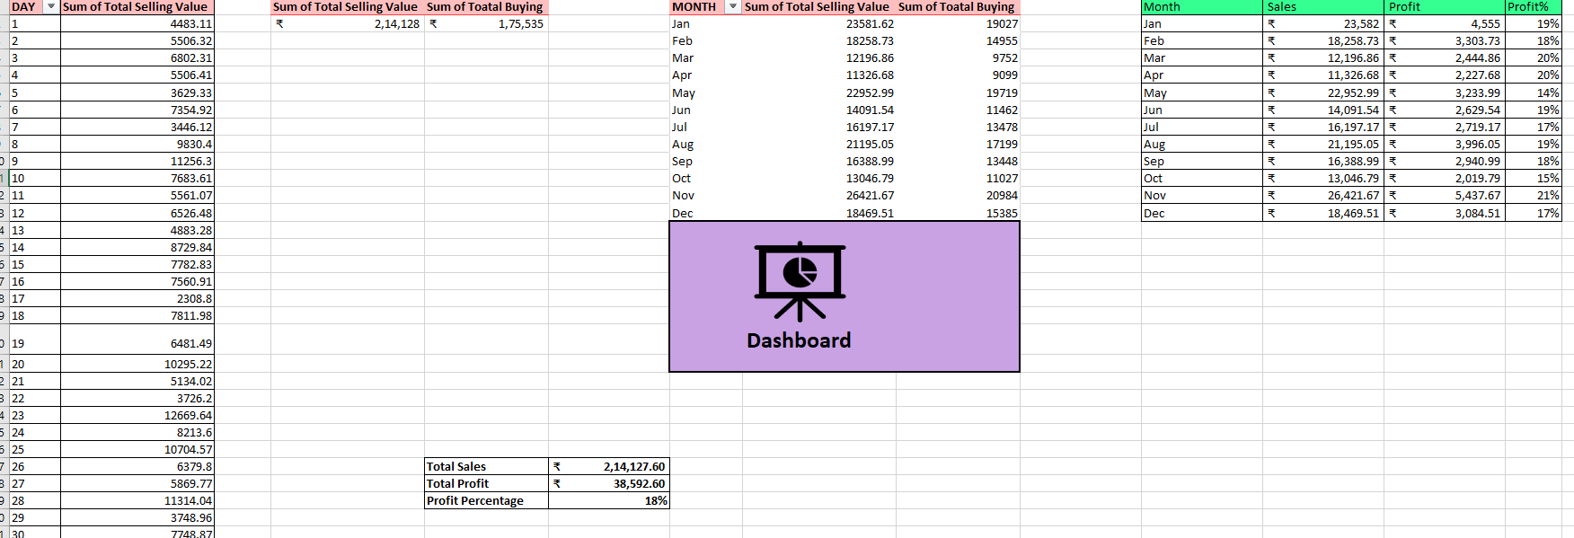

Slide 12
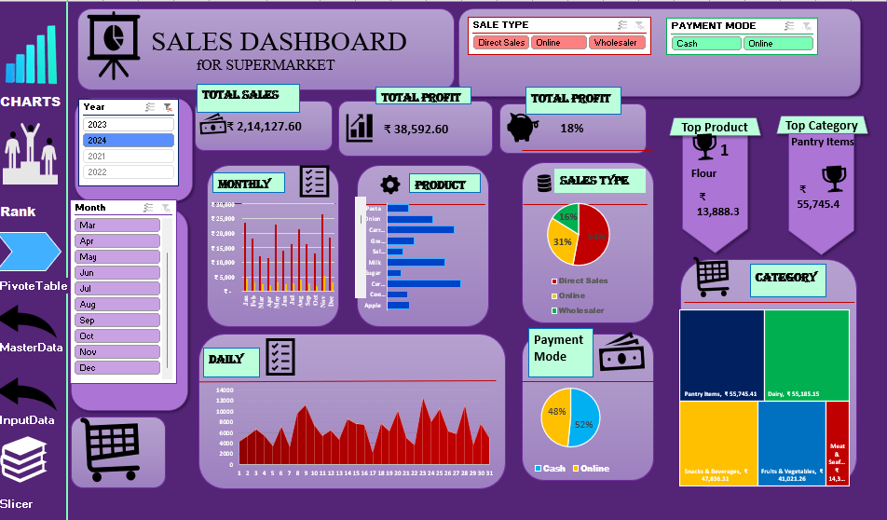

Slide 13
Thank you

